Slide 1


University of Wisconsin-Stout
Timer/Stopwatch Project
May 10, 2017

Slide 2

Project Idea
Utilize Keypad input and LCD output to create a timer
Timer can be set and controlled with keypad
Displays on LCD
If time allowed, add stopwatch functionality

Slide 3
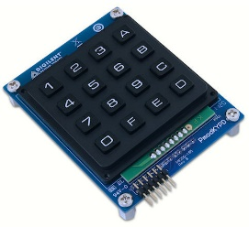
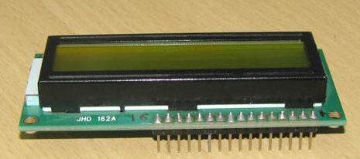
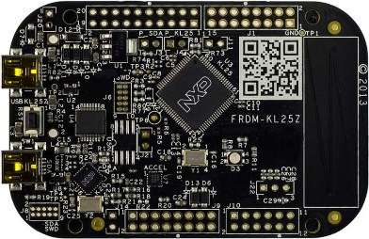
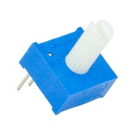
Bill of Materials
Quantity | Part | Cost
1 | 2x16 LCD Screen | $6
1 | PmodKeypad | $10
1 | KL25Z Freedom Board | $31.11
1 | Potentiometer | $1
 | Total | $48.11

Slide 4
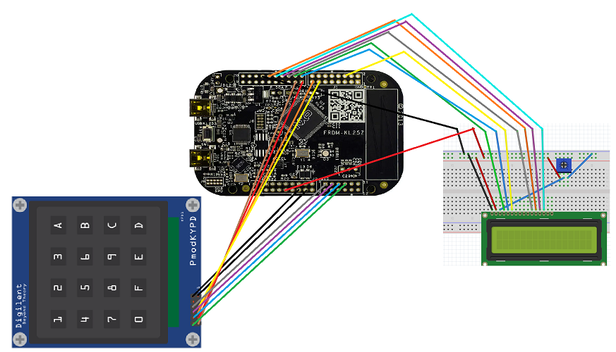
Circuit Schematic

Slide 5
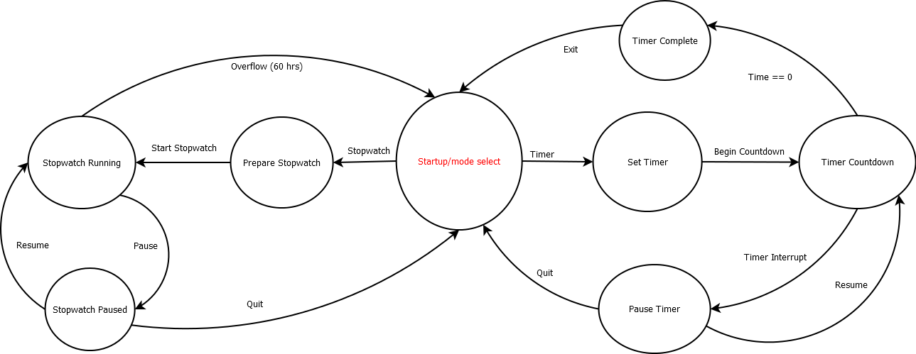
Operation Flow Chart

Slide 6
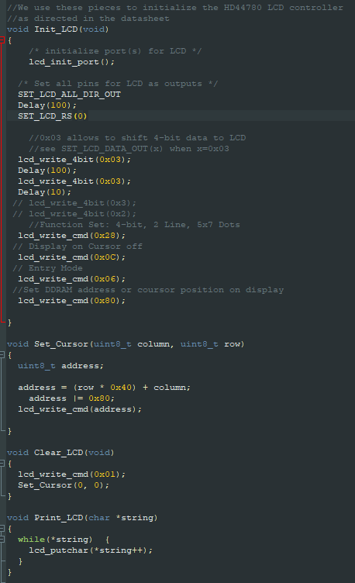
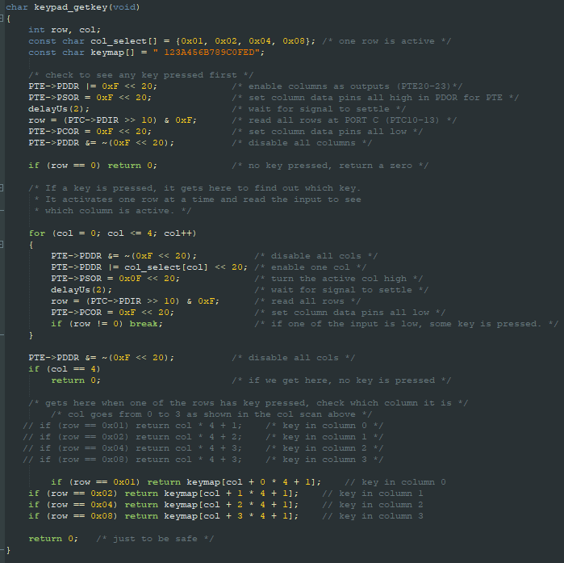
Lab-Based Code
Lab 10 - LCD
Lab 7 - Keypad

Slide 7
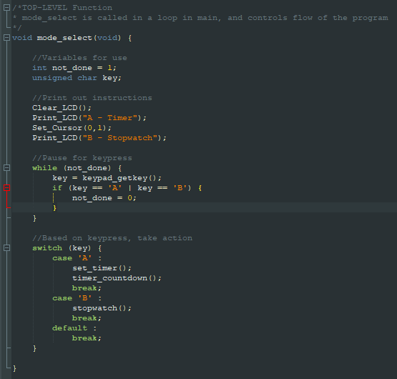
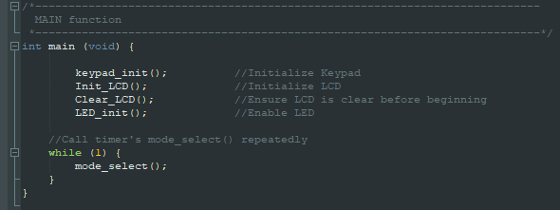
Top Level Modules

Slide 8
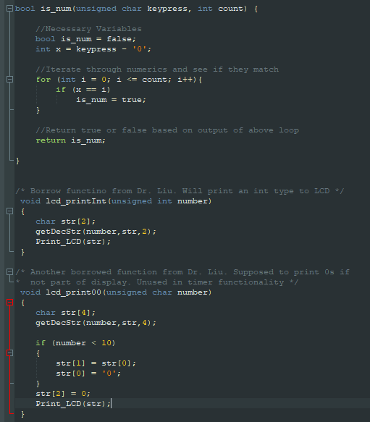
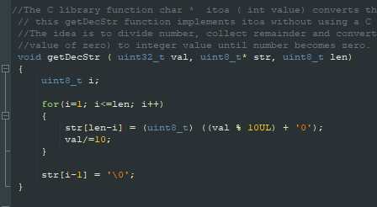
Important Functions

Slide 9
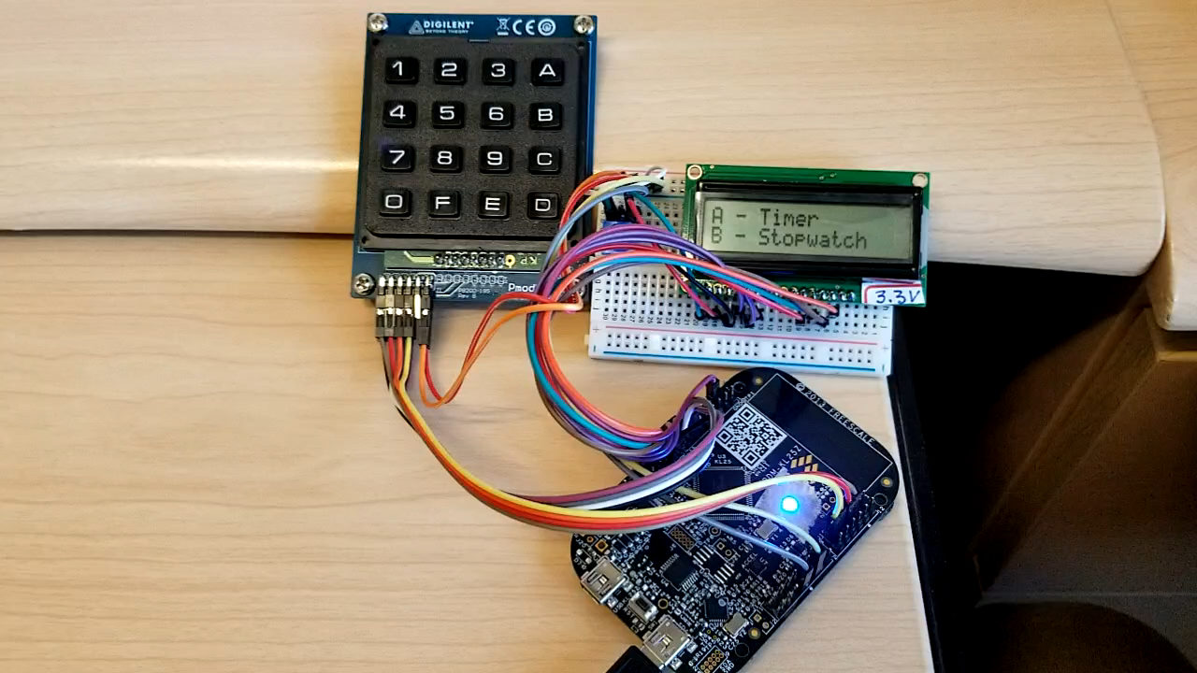
Demonstration and Questions

